Slide 1
FYP Proposal Presentation
Project Supervisor
Engr. Muhammad Nauman
Group Members
M. Junaid Maqsood (01-132202-015)
M. Hassan Khan (01-132202-022)
M. Zain-ul-Abeedin (01-132202-035)

Slide 2
Predictive & Preventive Maintenance System

Slide 3
Contents
Background
Problem Statement
Objectives
Methodology
Timeline
Scope
Literature Review
Dataset
Date Pre-Processing
Questions

Slide 4
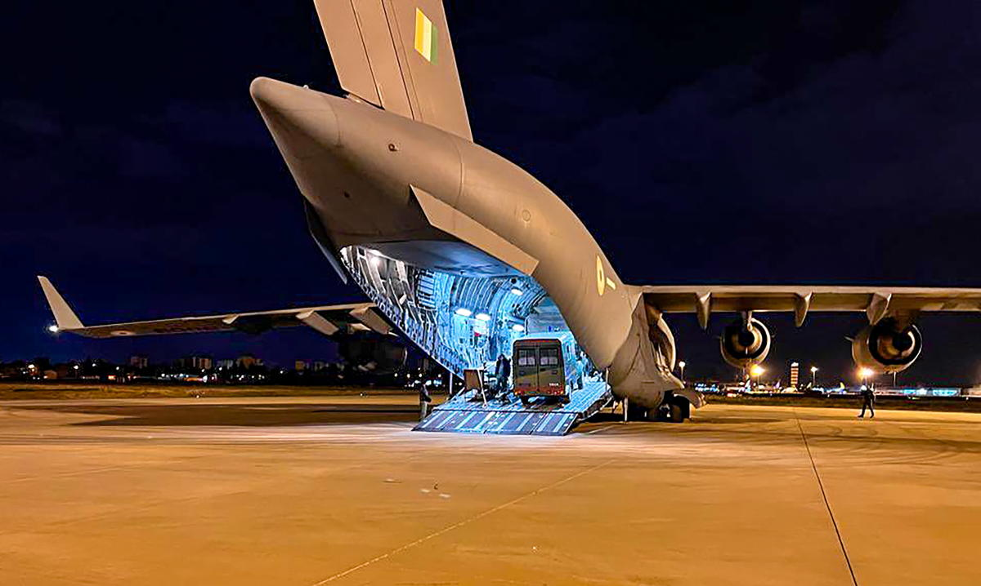
Background
The turbofan jet engines are an important part of aircrafts, and their reliable performance is crucial for air travel.
However, there can be unexpected failures or malfunctions in engines which can cause many problems such as
Increased maintenance costs.
Compromised passenger safety.
Flight cancellations.
Substantial financial losses for airlines.

Slide 5
Contd…
The Airline Maintenance Cost Executive Commentary Edition 2019 reported the annual maintenance, repair, and overhaul cost was 9% ($69 billion) of the total operational cost.
Traditional maintenance approaches, such as scheduled or reactive maintenance, often result in suboptimal resource allocation, increased downtime, and higher maintenance costs.
Pros
Simple
Familiarity
Cons
Reactive
Increased Risk
Inefficient
Lack of visibility

Slide 6
Contd…
Optimal Predictive Maintenance can be scheduled to reduce the maintenance cost and avoid equipment downtime.
The remaining useful life prediction algorithm in combination with RNN and LSTM long short-term memory .
The average accuracy ranges from 85-87%.

Slide 7
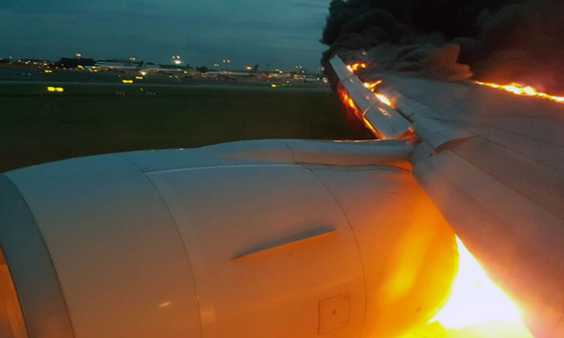
Problem Statement
To automate a system that calculates the remaining useful life of turbofan jet engines and alert the maintenance officers to provide maintenance to required aircraft before any failure or malfunctions occur.

Slide 8
Objectives
Predict the remaining useful life of turbofan engines.
Predict when an aircraft needs maintenance.
To achieve high accuracy.
Reduce maintenance costs.
Improve passenger safety.

Slide 9
Literature Review
S No. | Year | Method Used | Limitations
1 | 2018 | DCNN | Additional architecture improvements are required, as the current training time exceeds that of the majority of shallow networks in the literature.
2 | 2019 | ResCNN | The limitations of the proposed method are that the imbalance of signal data is ignored, and the tuning parameter process of the ensemble ResCNN is very time-consuming.
3 | 2019 | CNN-XGB | This main drawback of this method is the computational speed and cost, with a prediction time of around 621.7 s. It not cost-effective model in industrial contexts
4 | 2021 | FCLCNN-LSTM | The key drawback of this model is the need to incrementally update the prognosis results.

Slide 10
Contd…
S No. | Year | Method Used | Limitations
5 | 2009 | Introduction to deep algorithms. | Deep algorithms often demand substantial computational resources and large datasets, presenting challenges in terms of accessibility and interpretability.
6 | 2019 | Deep Convolution Neural Network | CNNs may lack invariance to certain transformations and demand extensive labeled datasets, while struggles with capturing global context are observed in some cases.
7 | 2016 | Deep Neural Network (DNN) Deep Belief Network (DBM) Convolutional Neural Network (CNN) | DNNs face challenges like vanishing/exploding gradients and hyperparameter sensitivity, posing obstacles to efficient training and optimal model configuration. DBNs suffer from lengthy training times and limited applicability, making them less suitable for real-time applications and diverse datasets. CNNs may struggle with understanding complex spatial relationships and are sensitive to hyperparameter choices, affecting their performance.
8 | 2017 | Long Short-Term Memory Network | LSTMs exhibit training complexity, demanding significant computational resources, and may face difficulties in capturing very long-term dependencies in sequences.
The average accuracy ranges from 85-87%.

Slide 11
Methodology
Acquiring Dataset
Feature Extraction
Model Training
Estimating Remaining Useful Life
Data Pre-processing
Feature Selection
Data Normalization
Importing the dataset.
Build an Architecture
Initialize Parameters
Train
Finish one Epochs
Maximum Epochs
Input Test Dataset
Remaining Useful Life Estimations.
Result Evaluation
Dashboard
Create a dashboard.
Add or remove device.
Easy to monitor condition of device.

Slide 12
Dataset
Data sets consists of multiple multivariate time series.
Each engine starts with different degrees of initial wear and manufacturing variation which is unknown to the user.
The engine is operating normally at the start of each time series, and develops a fault at some point during the series.

Slide 13
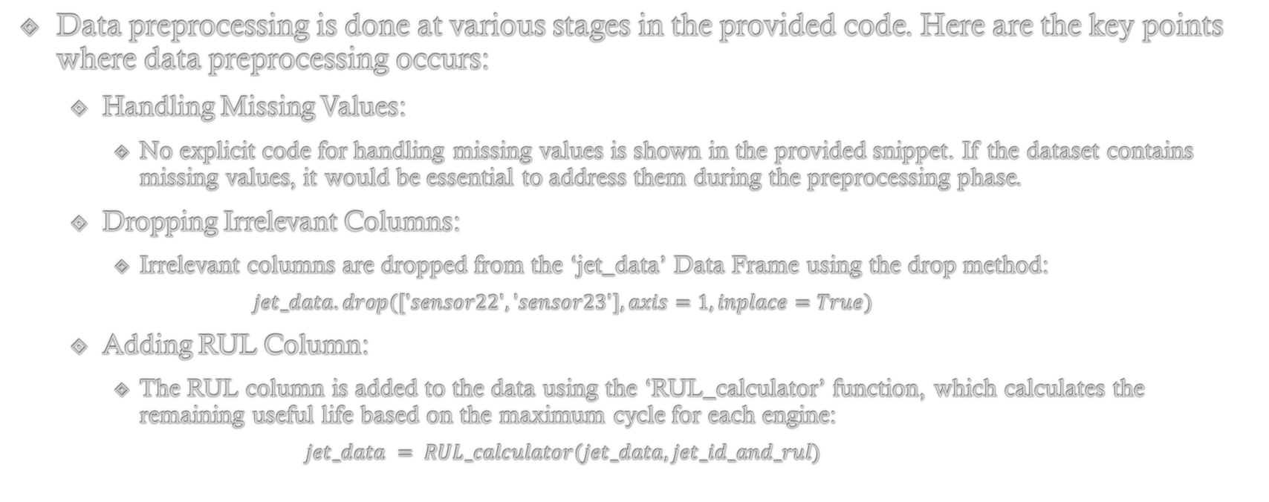
Data Pre-Processing
Data preprocessing is done at various stages in the provided code. Here are the key points where data preprocessing occurs:
Handling Missing Values:
No explicit code for handling missing values is shown in the provided snippet. If the dataset contains missing values, it would be essential to address them during the preprocessing phase.
Dropping Irrelevant Columns:
Irrelevant columns are dropped from the ‘jet_data’ Data Frame using the drop method:
$$jet_data.drop(['sensor22', 'sensor23'], axis=1, inplace=True)$$
Adding RUL Column:
The RUL column is added to the data using the ‘RUL_calculator’ function, which calculates the remaining useful life based on the maximum cycle for each engine:
$$jet_data = RUL_calculator(jet_data, jet_id_and_rul)$$

Slide 14
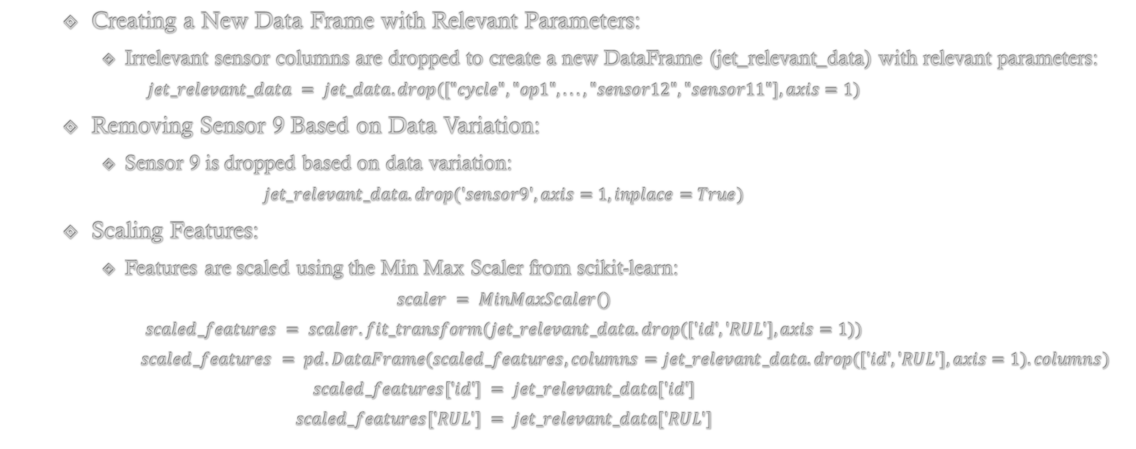
Contd…
Creating a New Data Frame with Relevant Parameters:
Irrelevant sensor columns are dropped to create a new DataFrame (jet_relevant_data) with relevant parameters:
$$jet_relevant_data = jet_data.drop(["cycle", "op1", ..., "sensor12", "sensor11"], axis=1)$$
Removing Sensor 9 Based on Data Variation:
Sensor 9 is dropped based on data variation:
$$jet_relevant_data.drop('sensor9', axis=1, inplace=True)$$
Scaling Features:
Features are scaled using the Min Max Scaler from scikit-learn:
$$scaler = MinMaxScaler() \\ scaled_features = scaler.fit_transform(jet_relevant_data.drop(['id', 'RUL'], axis=1)) \\ scaled_features = pd.DataFrame(scaled_features, columns=jet_relevant_data.drop(['id', 'RUL'], axis=1).columns) \\ scaled_features['id'] = jet_relevant_data['id'] \\ scaled_features['RUL'] = jet_relevant_data['RUL']$$

Slide 15

Contd…
Creating Target Variable and Feature Matrix:
The target variable (label) is created based on a threshold (cycle) for remaining useful life:
$$data['label'] = data['RUL'].apply(lambda x: 1 if x <= cycle else 0) \\ y = data['label'] \\ X = data.drop(['RUL', 'id', 'label'], axis=1)$$

Slide 16
Preferred Models
Machine Learning
Random Forest
Logistic Regression
Deep Learning
Long Short Term Memory

Slide 17
Scope
Aviation
Complex machines
Neglecting maintenance can lead to:
Mechanical failures
Risk of accidents
Compromise passenger safety
Decreased output quality
Industrial
Extensively used in industries:
Optimize production processes
Maintain efficiency
Neglecting maintenance can lead to:
Decreased efficiency
Machine may experience breakdown
Decreased output quality

Slide 18
Scope
Hospital:
Hospital equipment is critical for:
Patient care
Diagnostics
Treatment.
Neglecting maintenance can lead to:
Calibration errors.
Malfunction.
Inaccurate readings.
Networking fields for maintaining servers in warehouses:
Backbone of IT infrastructure supporting:
Data storage.
Processing.
Network operation.
Neglecting maintenance can lead to:
Decreased performance.
System crashes.
Potential security breaches.

Slide 19
Timeline
Stage 1
(June 2023 – July 2023): Project problem view, proposal preparation and defense.
Stage 2
(July 2023 – September 2023): Literature Review, learning required concepts and installation of required tools.
Stage 3
(September 2023 – November 2023): Performing pre-processing, feature engineering etc. on the dataset.
Stage 4
(December 2023 – January 2024): Implementation and training of Deep Learning model used to predict remaining useful life and maintenance time.
Stage 5
(January 2024 – March 2024): Create front end for operator to check the statistics and when the maintenance is required.
Stage 6
(March 2024 – May 2024): Final Research Document, Submission of Project, and Final Defense.

Slide 20

Thank You!
Any Questions?

